Slide 1

AI and Machine Learning for IoT Big Data

Slide 2
Dissecting Deep Learning

Slide 3
Lecture 5: Dissecting Deep Learning
Review of Deep Learning
Example: Plant Disease Detection
Images as input
Network structure
Activations
Transfer learning
Results, discussion

Slide 4
What is (“shallow”) Learning?
We create “features” from the input data: for instance, “formants” for speech, “texture” for images, … (based on domain knowledge)
Learning modifies all layers
Use one or a few “hidden” layers
Learning can be done with relatively little data
Learning is fairly quick
Notes:
A lot of research have been done in the past to design and refine feature generation
Neural Networks have been used for decades; the biggest change is the abundance of processing power

Slide 5
Some feature extraction methods
Images: texture statistics contours
Voice: spectrum (FFT) cepstrum formant structure

Slide 6
What is Deep Learning?
Features are learned, not extracted by human-made algorithms
Learning proceeds by layers, creating feature-generating structure for the input
Use a lot of layers
Use a lot of data
Learning is computationally intensive
Notes:
Point out the similarity with sensory information processing in the brain

Slide 7
The Turning Point: Deep Learning
A View from Emerging Technology from the arXiv
The Revolutionary Technique That Quietly Changed Machine Vision Forever
Machines are now almost as good as humans at object recognition, and the turning point occurred in 2012, say computer scientists.
September 9, 2014
https://www.technologyreview.com/s/530561/the-revolutionary-technique-that-quietly-changed-machine-vision-forever/
Notes:
Sudden breakthroughs occur almost at the same time in vision, speech recognition, text analysis etc.
Real-time image recognition is reaching human performance levels.
Google’s or Amazon’s speech recognition engines are finally practically useful and used daily.

Slide 8
ImageNet Large-Scale Visual Recognition Challenge
… all that changed in 2012 when a team from the University of Toronto in Canada entered an algorithm called SuperVision, which swept the floor with the opposition.
https://www.technologyreview.com/s/530561/the-revolutionary-technique-that-quietly-changed-machine-vision-forever/
Notes:
a technique called deep convolutional neural networks which the Super Visison algorithm used to classify the 1.2 million high resolution images in the dataset into 1000 different classes.

Slide 9
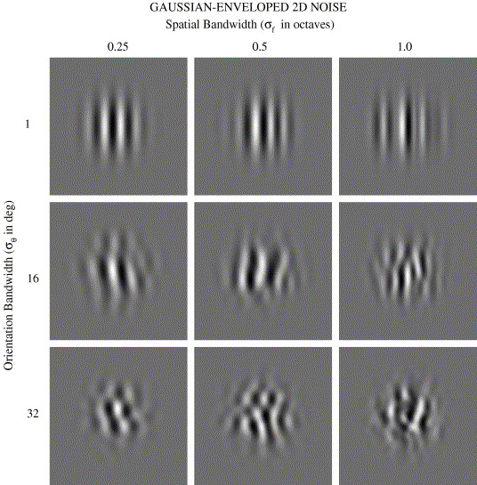
Background: neuro-physiological research in humans and primates
Development of sensitivity to visual texture modulation in macaque monkeys
Yasmine El-Shamayleh, J. Anthony Movshon, and Lynne Kiorpes
Orientation discrimination in human vision: Psychophysics and modeling
Author links open overlay panel
William H.A.BeaudotabKathy T.Mullena
Neural circuits extract “generally useful” information from the visual signal; these will be combined gradually into higher-order features, eventually allowing object recognition and other high-level visual tasks.
Notes:
Psychological and physiological experiments established the initial processing model for vision.
Researchers found neurons responding selectively to specific spatial frequencies, specific
orientations, specific texture patterns etc. These neurons are replicated across the visual field.
This gave the hint to LeCun, Hinton, and others, to develop a similarly structured neural network
model: the Convolutional Neural Network.

Slide 10
ImageNet and its followers
Convolutional neural networks consist of several layers of small neuron collections that each look at small portions of an image. The results from all the collections in a layer are made to overlap to create a representation of the entire image. The layer below then repeats this process on the new image representation, allowing the system to learn about the makeup of the image.
Deep convolutional neural networks were invented in the early 1980s. But it is only in the last couple of years that computers have begun to have the horsepower necessary for high-quality image recognition.
https://www.technologyreview.com/s/530561/the-revolutionary-technique-that-quietly-changed-machine-vision-forever/
Notes:
Deep convolutional networks are based on a biological model of human vision
The visual cortex has a layered structure, first doing local feature extraction
Similar structures are useful for other sensory tasks (hearing etc.)

Slide 11
An Example: Plant Disease Detection

Slide 12
Plant Disease Detection
Cultivated plants are attacked by pests etc.
Farmers in developing countries need help
Detection of diseases is difficult
Agronomical knowledge is rare, expensive Basic idea:
Collect images of healthy and diseased plants
Train AI to recognize diseases
Notes:
What are the choices of a farmer observing decreased productivity or quality?
Use traditional methods
Ask help from fellow farmers
Ask help from agronomists
Search for information in books or on the Internet
Which of these are available in developing vs. developed countries?

Slide 13
Reason for Deep Learning (DL)
No clear theoretical foundation for feature selection, for disease detection in plant images
However, many samples can be collected, satisfying the requirements for DL
The huge training dataset and computational load can be handled by Big Data technologies
The resulting AI classifier can be executed on smaller computers (mobile phones etc.)
Notes:
Motivating example: the success of DL methods for human face recognition (Facebook, photo albums etc.)

Slide 14
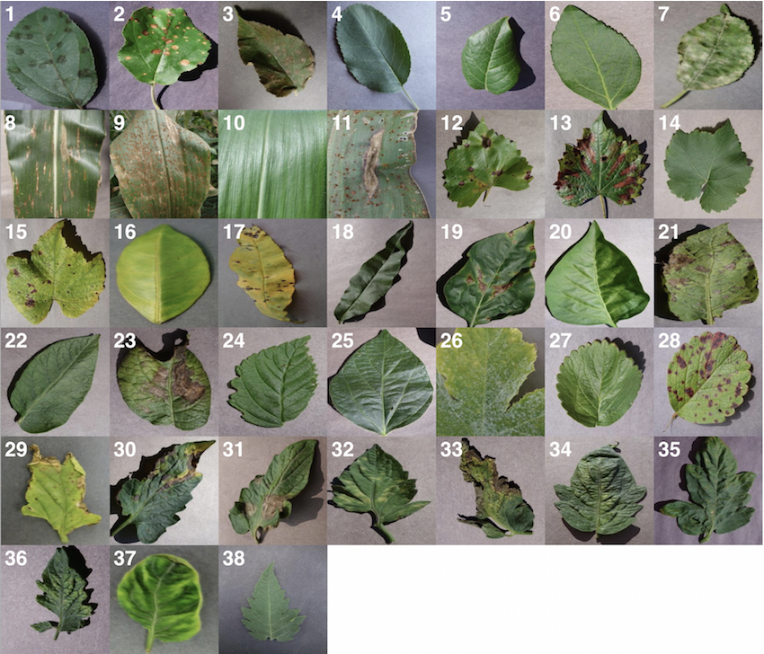
Sample images of various plant diseases from PlantVillage
Credits: Using Deep Learning for Image-Based Plant Disease Detection
Sharada Prasanna Mohanty1,2, David Hughes3,4,5, and Marcel Salathé1,2,6
https://arxiv.org/pdf/1604.03169.pdf

Slide 15
Discussion
What are the apparent characteristics of plant disease in the images?
How would you create an operational description to be used by a human? Like e.g. “look for whitish spots near the stem” etc.
How would you program the descriptions as executable feature extraction?
Notes:
Assignment: download sample image sets from PlantVillage; try to give a description of the disease symptoms

Slide 16
Deep Learning network
Structure: Convolutional Neural Network
Modeled on the mammal early vision system
Intermediate layers have receptive fields
Connections are replicated
Features are generated automatically

Slide 17
Typical convolutional neural network
Credit: Aphex34 (https://commons.wikimedia.org/wiki/File:Typical_cnn.png), https://creativecommons.org/licenses/by-sa/4.0/legalcode
Notes:
Explain convolution
Explain subsampling
Discuss why there are several levels

Slide 18

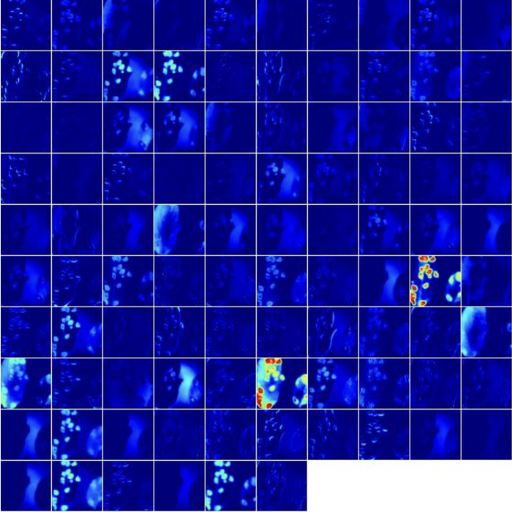
Activations in intermediate layer
Credits: Using Deep Learning for Image-Based Plant Disease Detection
Sharada Prasanna Mohanty1,2, David Hughes3,4,5, and Marcel Salathé1,2,6
https://arxiv.org/pdf/1604.03169.pdf
Notes:
Explain activation

Slide 19
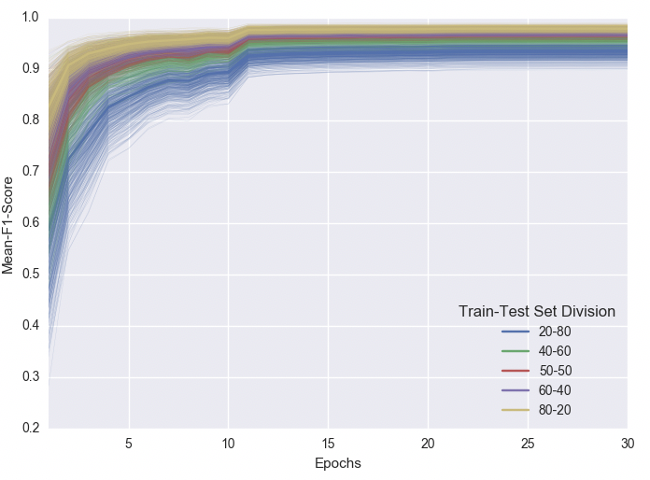
Progress of learning through 30 epochs
Credits: Using Deep Learning for Image-Based Plant Disease Detection
Sharada Prasanna Mohanty1,2, David Hughes3,4,5, and Marcel Salathé1,2,6
https://arxiv.org/pdf/1604.03169.pdf

Slide 20
Feature Transfer
An efficient trick for DL: domain-specific feature extraction shared between tasks
Train a DL network properly, then copy the input layers into another DL network
Most useful when:
we have a task with only a few data points
we have other tasks in the same domain with lots of available data

Slide 21
Transfer learning: re-use the trained feature maps
TASK 1
TASK 2
Credit: Aphex34 (https://commons.wikimedia.org/wiki/File:Typical_cnn.png), https://creativecommons.org/licenses/by-sa/4.0/legalcode

Slide 22
Typical usage of Deep Learning
Well suited to processing of natural data (images, sounds, language, weather)
Can be used to create robust processors (autonomous cars, surveillance)
Enables the transfer of internal representations among AI systems
Many variants, designed for specific tasks (CDBN, DSN, TDSN, DPCN, …)

Slide 23
Some criticism

Slide 24
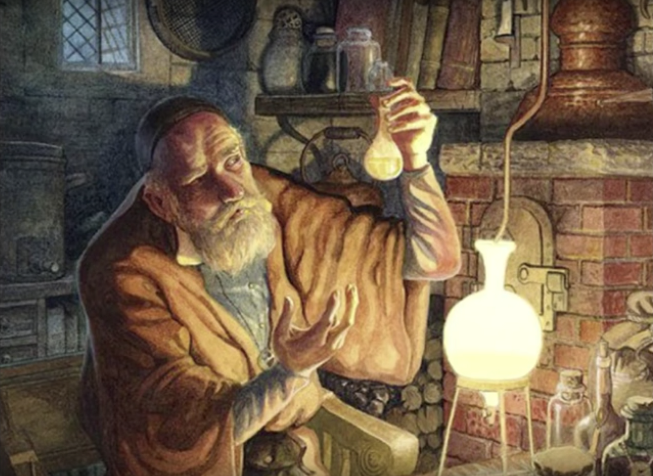
Try it and it (sort of) works. Good enough?
LeCun vs Rahimi: Has Machine Learning Become Alchemy?
The debate started with Google’s Ali Rahimi, winner of the the Test-of-Time award at the recent Conference on Neural Information Processing (NIPS). Rahimi put it bluntly in his NIPS presentation: “Machine learning has become alchemy.”
https://medium.com/@Synced/lecun-vs-rahimi-has-machine-learning-become-alchemy-21cb1557920d
Notes:
Google’s Ali Rahimi, winner of the the Test-of-Time award at the recent Conference on Neural Information Processing (NIPS)… put it bluntly in his NIPS presentation: “Machine learning has become alchemy.”
As AI gradually penetrates critical fields such as law and healthcare, the debate is bound to reignite.
Discuss how important is a theoretical foundation. Which point of view do you subscribe to?
it works, let’s use it!
without theory, we cannot tell if it gives correct results in a new field, so must check and cross-verify every time!

Slide 25
Discussion
Search for existing success stories with DL
Search for potential new applications:
What makes a problem promising for DL?
Data with structure?
Large sample sets?
Search now in the context of IoT:
Sensors?
Images?
Notes:
Start from Google, Amazon, IBM, the big players.
Then take a look at startups, niche companies.

